Slide 1
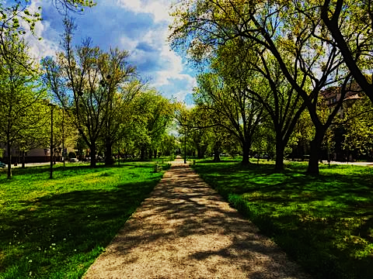

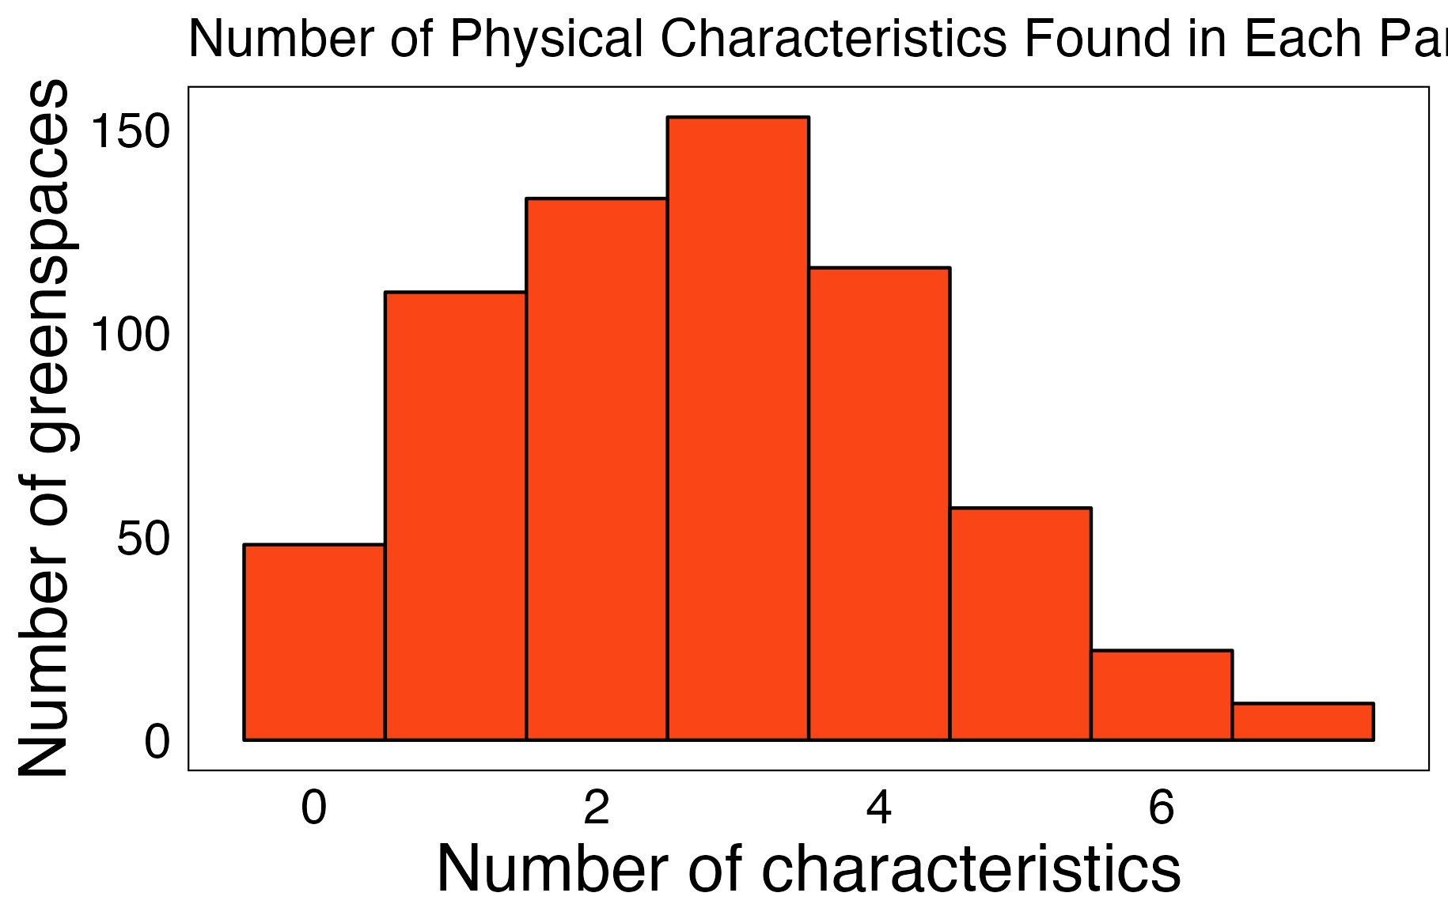
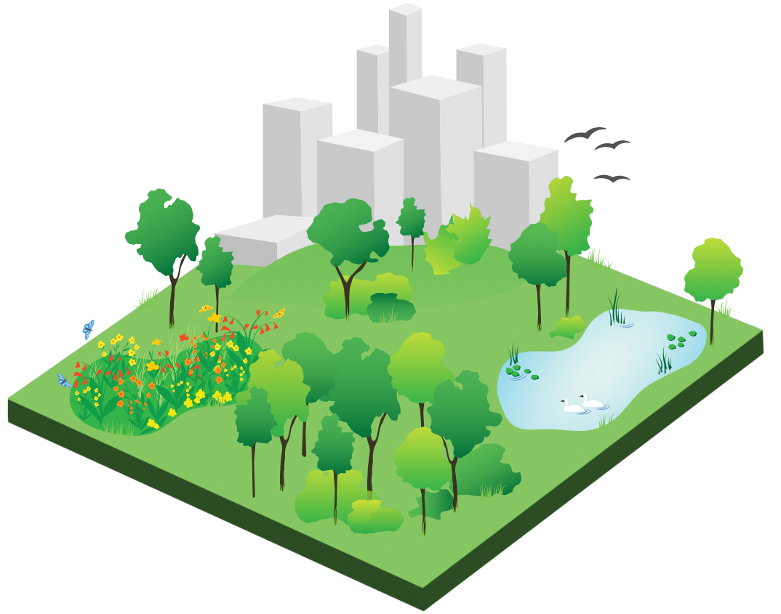
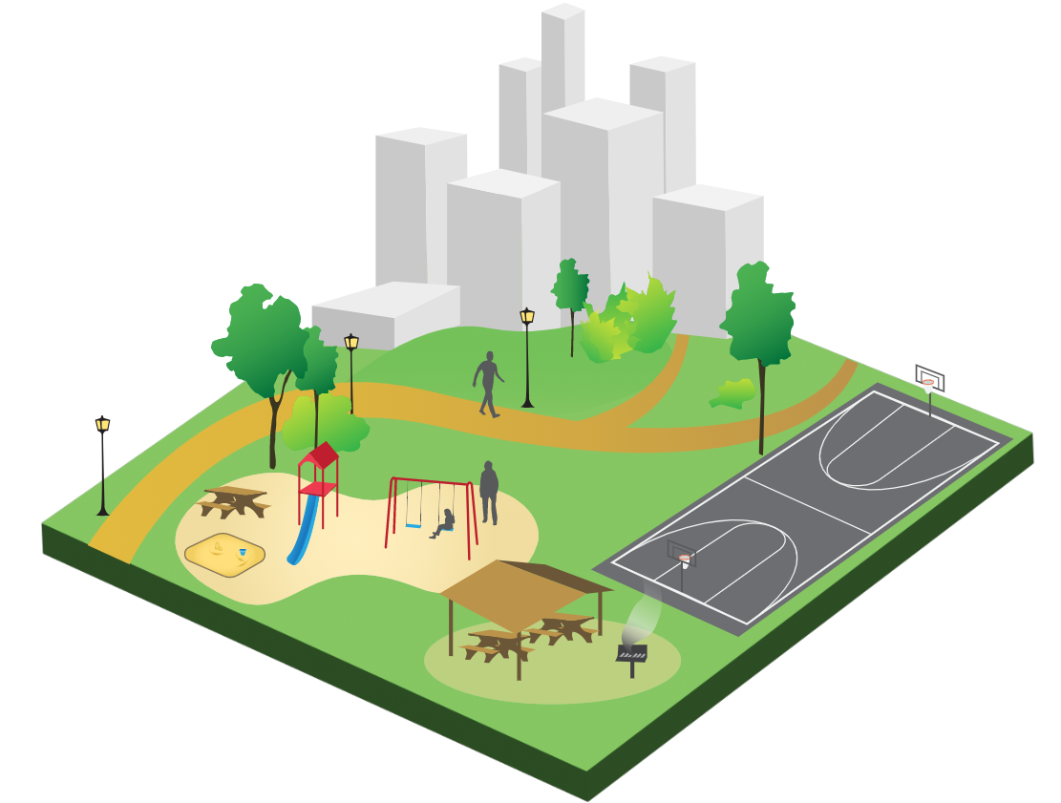
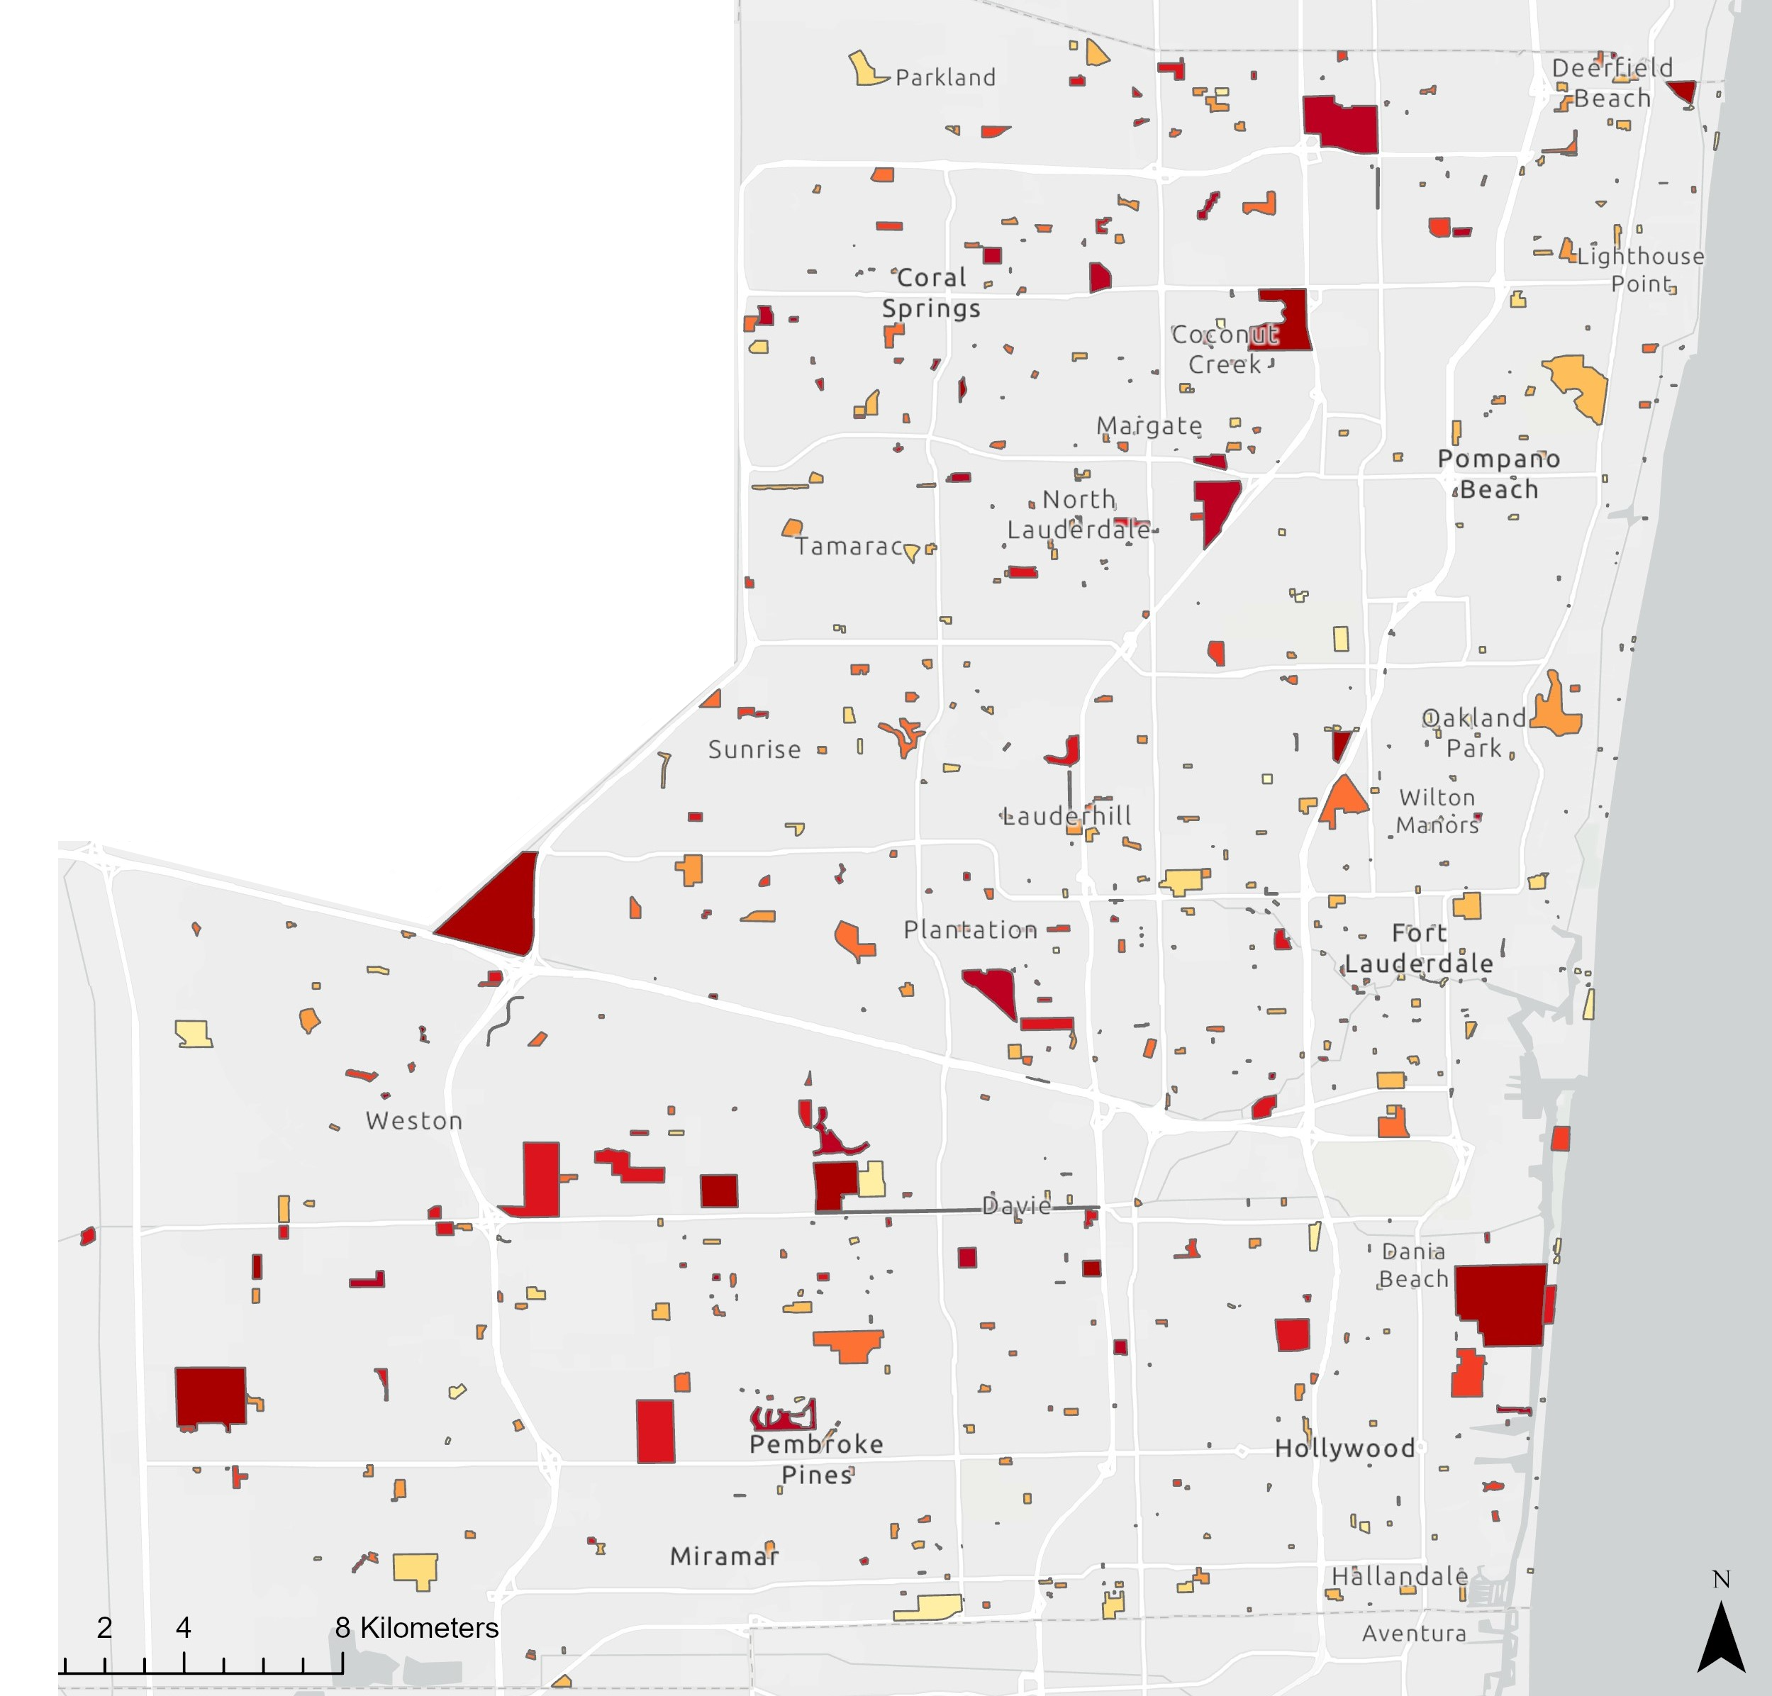
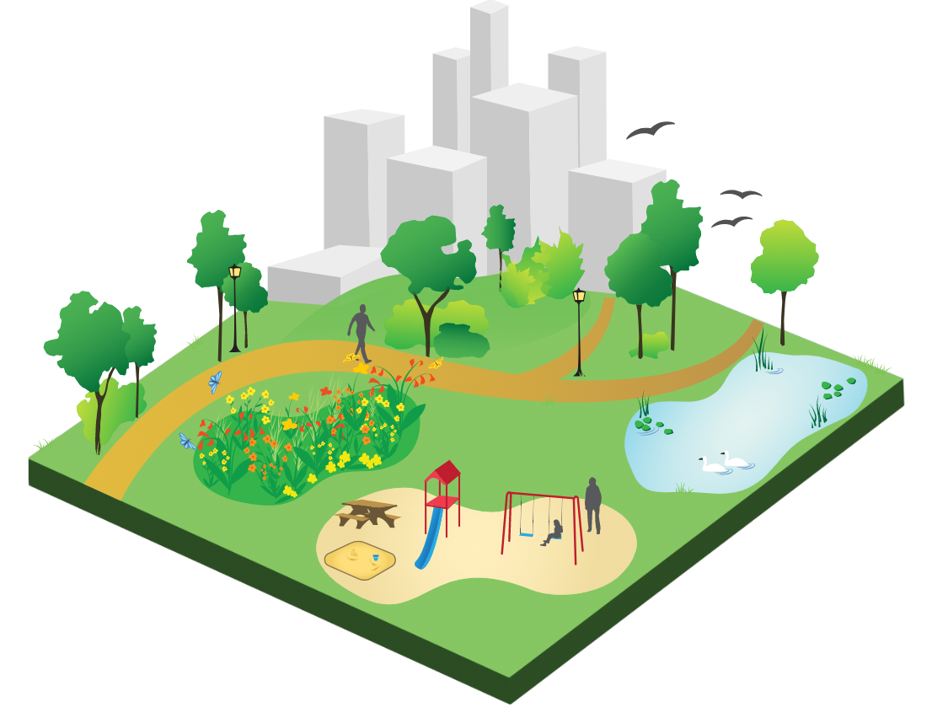
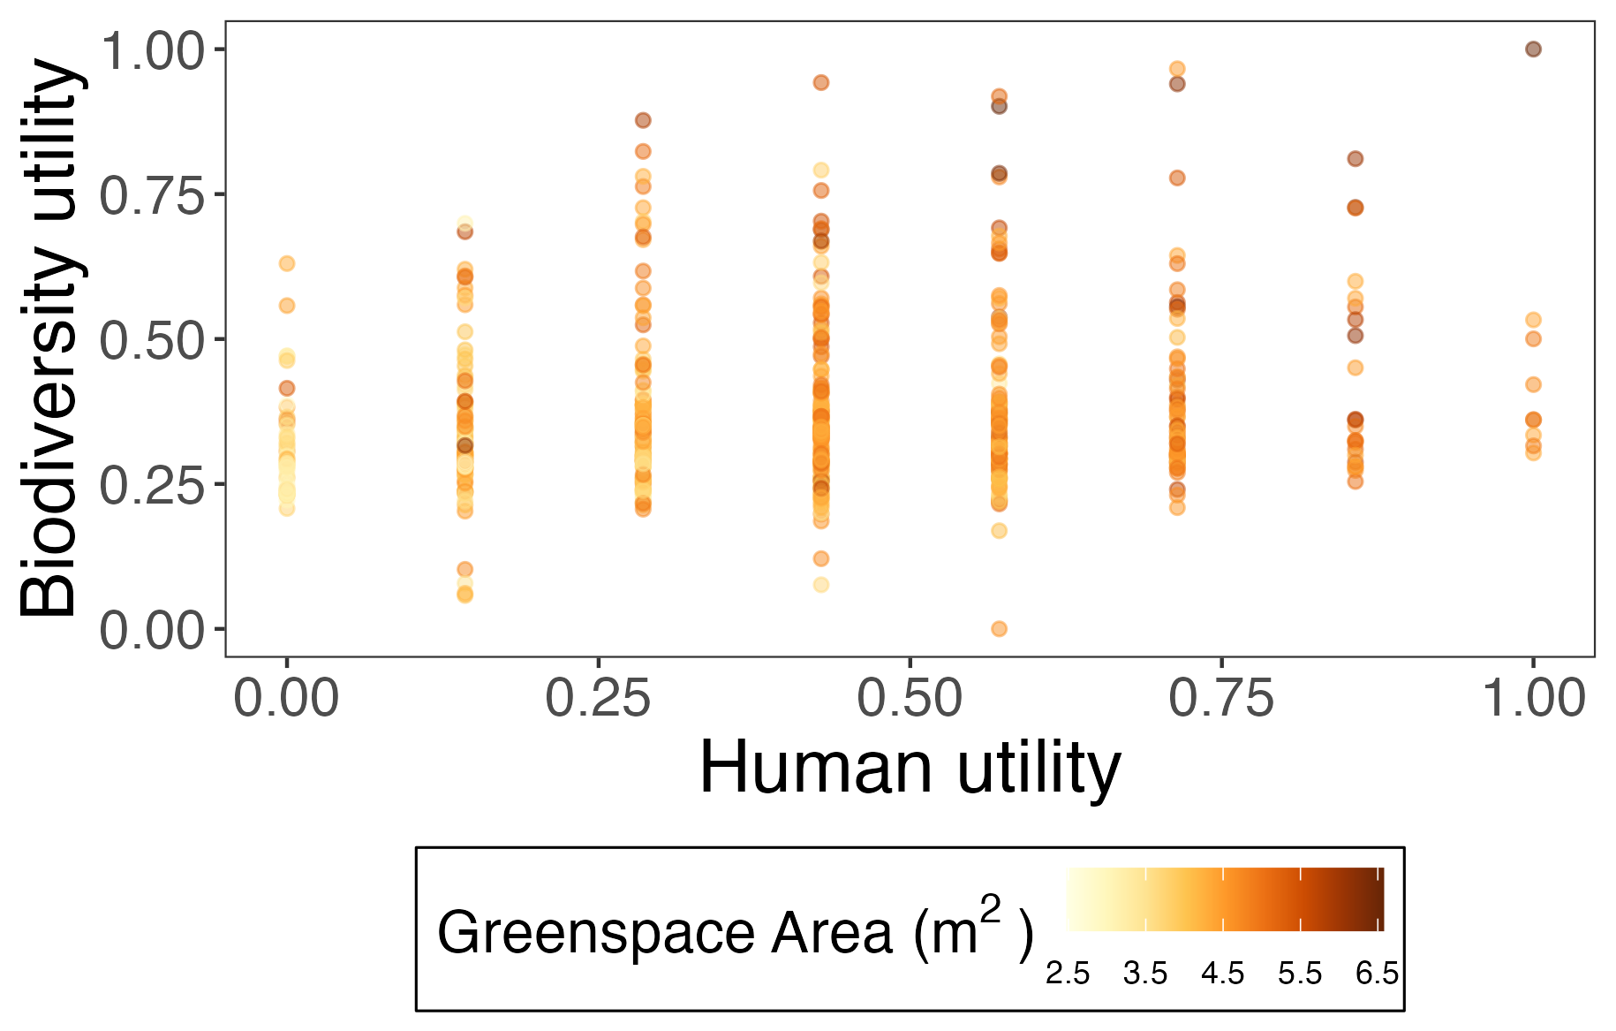




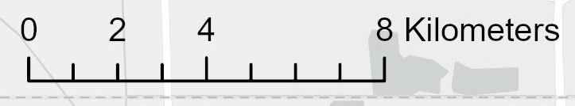






Key finding: We found no evidence of tradeoffs in biodiversity and human utility, meaning large greenspaces can accommodate diverse values.
Quantifying the synergies between human and biodiversity utility in urban greenspaces
Nataly G. Miguez¹, Brittany M. Mason¹, Jiangxiao Qiu², Corey T. Callaghan¹
Department of Wildlife Ecology and Conservation, Fort Lauderdale Research and Education Center, University of Florida
BACKGROUND
Rapid urbanization is a process characterized by a significant shift of a population from rural to urban areas.
By 2050, the global urban population is projected to increase from 55% to 68%.
Urban greenspaces play a crucial role in urban environments due to their role in providing essential habitats to various forms of wildlife, and the enhancement of ecosystem services (e.g., air and water purification, climate regulation, carbon sequestration).
Figure 2. Frequency of the eight physical characteristics
Key Question:
Are there synergies or tradeoffs between biodiversity and human utility in urban greenspaces?
RESULTS
Human utility was normally distributed across the eight physical characteristics (Figure 2).
Statistical analysis revealed significant positive correlations between kid's playgrounds, bodies of water, nature preserves, and jog/walk paths with biodiversity utility.
No evidence of a relationship between biodiversity and human utility, indicating the absence of tradeoffs (Figure 3).
Predicted Richness
300
250
200
150
High biodiversity utility
High human utility
Nature Preserve
Body of Water
Fitness Center
Walk Path
Athletic Field
Picnic Area
Playground
Dog Park
Figure 1. Broward County, Florida, and the 647 greenspaces colored by standardized species richness.
Figure 3. Comparison of human utility and biodiversity utility value by log-transformed greenspace area
METHODS
CONCLUSIONS
We mapped 647 urban greenspaces throughout Broward County (Figure 1).
For human utility, we defined a list of eight physical characteristics and determined the presence or absence of each variable.
For biodiversity utility, we predicted species richness for a set number of observations for all greenspaces using iNaturalist data.
Both human utility and biodiversity utility correlate with greenspace size, emphasizing the significance of larger greenspaces in accommodating diverse values and use.
Future work should look to scale-up these results to other parts of the country and leverage big data to quantify both biodiversity and human utility.

